Slide 1
Hacking Race
By @HerroAnneKim, Anvita Pandit, Bobby Hunt
Content warning: Slavery
Notes:
Our underground railroad - UTAH
Linear aspect of PCA make it better than a non-linear separator
Anthropology
Genomics testing: oncological data - once it has been released to a pharmaceutical company
Genetic non-discrimation act, no protection from life insurer
Law enforcement only has access to two databases
What happens when these companies goes bankrupt
3 anthropologists, 5 bio people, 7 computer cpeople, 25 people total

Slide 2
Takeaways
Race is fake
Genetics testing for ancestry is limited
Don’t trust genetics testing companies!

Slide 3
Race is Dumb

Slide 4
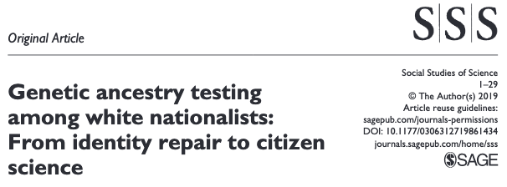
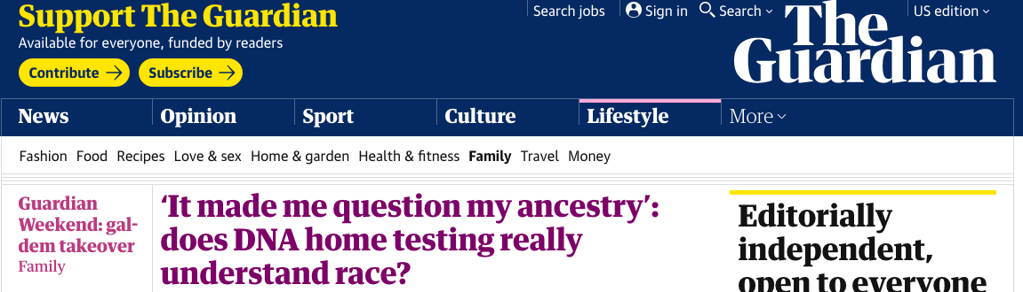
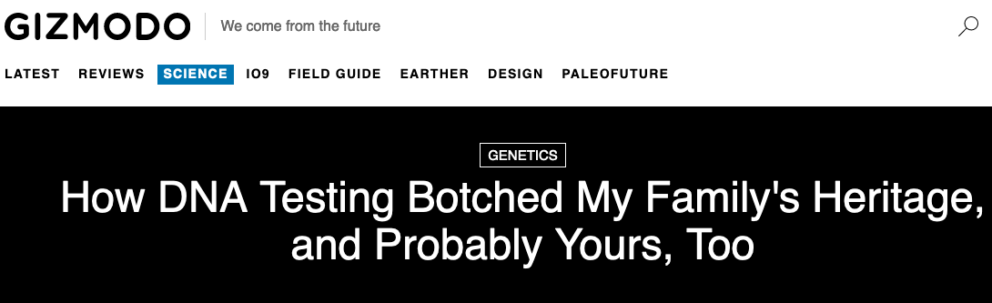
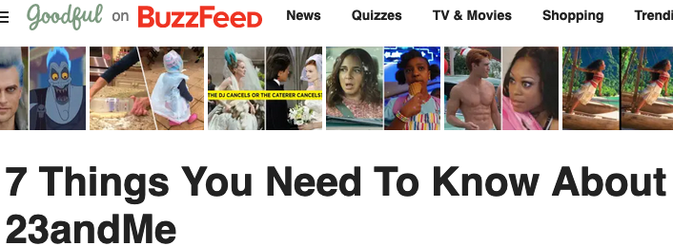
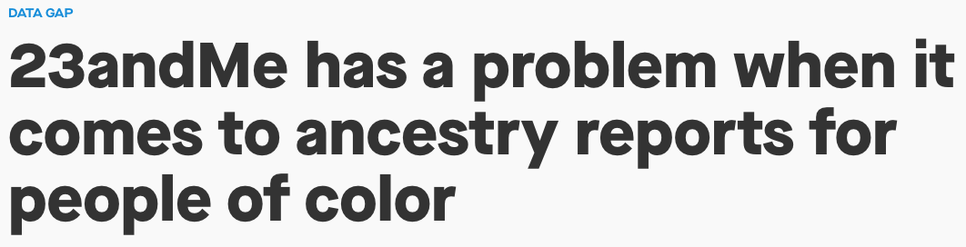
But people are obsessed with “genetic” race
Notes:
With the increased availability of direct-to-consumer (DTC) genetic testing, we’ve seen an explosion of interest in getting these tests
People are kind of obsessed with this stuff...
Despite how incorrect or problematic the results can be…
How can “science” and genetics be so “wrong”?
WELL, let’s consider the definition of what we’re assessing here….
https://qz.com/765879/23andme-has-a-race-problem-when-it-comes-to-ancestry-reports-for-non-whites/
https://gizmodo.com/how-dna-testing-botched-my-familys-heritage-and-probab-1820932637
https://www.theguardian.com/lifeandstyle/2018/aug/11/question-ancestry-does-dna-testing-really-understand-race
https://www.npr.org/2019/07/05/738949320/episode-924-stuck-in-chinas-panopticon
https://www.buzzfeednews.com/article/peteraldhous/golden-state-killer-dna-experiment-genetic-genealogy
https://www.buzzfeed.com/tomvellner/23-and-me-dna-kit-explained
https://journals.sagepub.com/doi/full/10.1177/0306312719861434

Slide 5

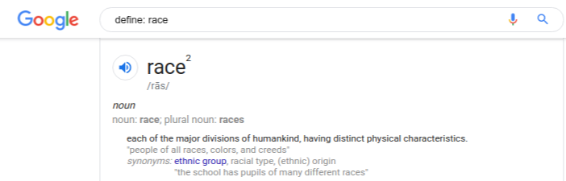
Notes:
<not the first result - joke>
Race is a culturally constructed label that very crudely and imprecisely describes real genetic variation. When we say it’s a cultural construct, we don’t mean that skin color is made up. Skin color is in your DNA.
We’re saying that establishing categories along lines of skin color - white, black, asian - has no genetic basis. No genetic basis that makes skin color the meaningful threshold upon which we can make divisions of humans.
____
[Santos et al, 2009) , [Templeton, Biological Races in Humans]

Slide 6
Race is Dumb--We made it up
Notes:
For example, researchers who assessed the geographic ancestry of self-declared “whites” and “blacks” in the United States and Brazil and found that many Brazilian “whites” had more African ancestry than US “blacks”. So the culturally defined categories of white and black do not have the same genetic meanings in United States and Brazil

Slide 7
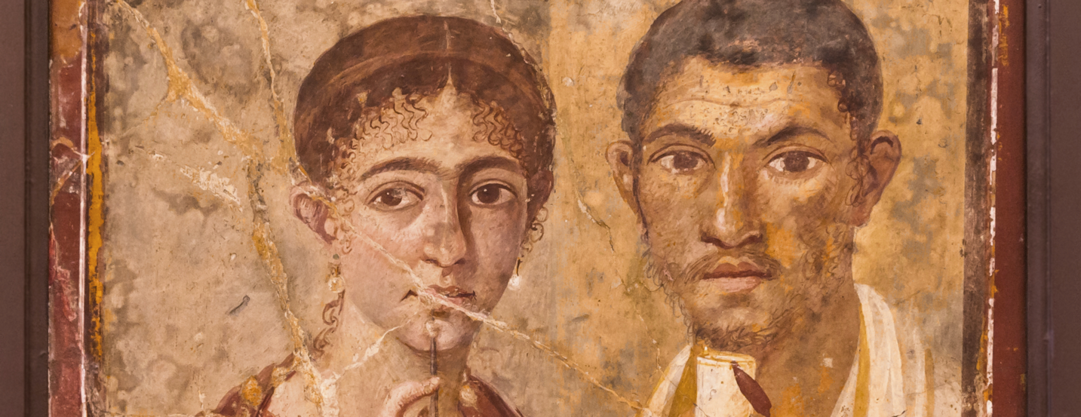
Fresco from Pompeii of Terentius Neo and his wife (c. 50–79 CE)
Notes:
A little bit of history of racial science in Europe/America. From 1700s - 1800s: Racial science was hugely popular to debate publicly. Two theories prevailed:
Polygenesis - white people (Europeans) come from the Garden of Eden, other peoples did not. Africans, American indigenous peoples, etc. were different human species. This was backed up by skull diagrams and anthropologists of the day.
Climate theory - hot weather breeds degeneracy and physical disorders like dark skin and kinky hair. Cold weather and exposure to European culture could cure it.
At the heart this was a debate on whether non-Europeans people were distinct from Europeans from the origin, or whether time and climate had made them inferior. Europeans at this time could not imagine the other option: that in fact they had descended from the Africans.
___
Stamped From the Beginning, pg. 113, 111

Slide 8
You’ve probably heard mulatto but have you heard:
quadroon
octoroon
griff
sacatra
Notes:
These weren’t just skin colors back then, but important racial divisions. In slave-holding America, Slave sales would list these labels, and buyers would use them for determining the type of job a slave would have: field or house.
---
Stamped From the Beginning, pg. 113, 111

Slide 9
Race is Dumb--and different from Ancestry and Genetics

Slide 10

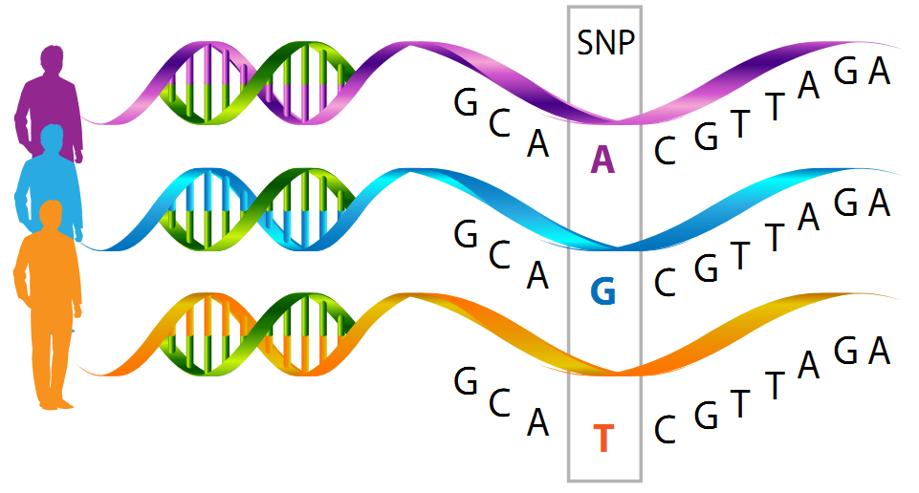
Genetics Crash Course
Notes:
An individual’s genome is sequenced based off a DNA sample (spit works)
>95% of that genome will be exactly the same as every other humans. The remaining 5% variation is very important for distinguishing that human
We refer to the DNA variations as SNPs, there are other kinds of mutations but SNPs are most relevant for categorizing.
Some SNPs are highly correlated within ethnic groups. Genetic information comes from our ancestors, but it gets scrambled (recombined) as it gets passed down. Example of an ethnic group: Han Chinese, Yoruba from Nigeria.

Slide 11
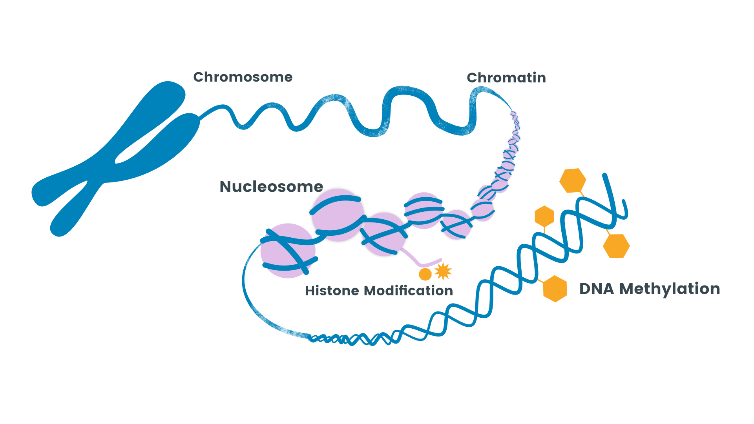
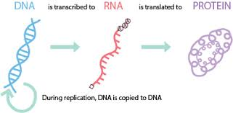
Genetics Crash Course
Notes:
The phenotype (observable traits) is determined from the genotype and epigenome
Regulatory DNA determines which genes in the genotype are enhanced in the resulting phenotype, and which ones are repressed.
This is referred to as the effect size of a gene and is almost entirely empirically determined

Slide 12
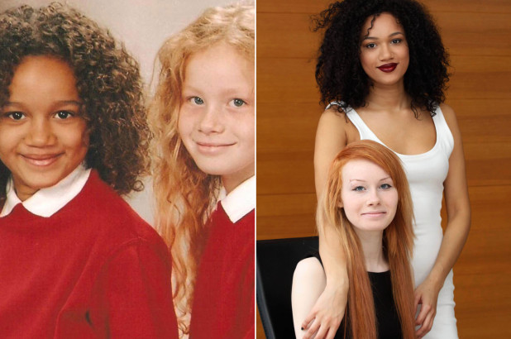
https://nypost.com/2015/03/02/meet-the-bi-racial-twins-no-one-believes-are-sisters/
Notes:
These women are twins.
If people looked at them closely they would see a striking facial similarity between them. But because we use just a couple cues like hair texture and coloration as indicators of racial membership we are prone to see these sisters as unrelated and unlikely to share the same parents. What is going on here? When we say that people are on average 50% related to each parent this really means that they have a 50% chance of inheriting any given allele that a parent has. Traits like hair texture and skin tone are complex traits governed by lots of different alleles.
During the process of recombination (whereby future parents produce unique eggs and sperm), and then fertilization (where a specific sperm and egg combine), some siblings will end up with more light skin alleles and others with more dark tone alleles....just by chance. In fact most siblings will end up with middle-ish numbers of light and dark skin alleles in such a circumstance and look like these women's other siblings. Just to be clear, the daughter in this scenario that has lighter skin is not necessarily more likely to have more alleles from her white father than from her black mother in other parts of the genome. This is because different genes that are not linked (close to each other on chromosomes) will be inherited independently (independent assortment for anyone who remembers Mendelian genetics 101).
<Example and test from Cristina Moya>

Slide 13
Determining ancestry
Customer DNA chunk: G C A T C G T T A G A
Variant site 2001 out of 500K
Variant A is most common in Purple populations
Variant B is most common in Blue populations
Variant T is most common in Orange populations
Notes:
With that understanding, let’s look at how genetics testing companies calculate your ancestry. They have access a proprietary panel of informative SNPs that differ between ethnicities. This panel is garnered from publicly available DNA sets with ancestry labels, but mostly it’s from their own customers, using self-reported ancestries. 23AndMe uses in total around 0.5M SNPs or about 0.016% of the genome, though Chinese researchers were able to tell the difference between Han Chinese and minority Uighur populations using only 35 SNPs (guess why they need to do that!).
The genetics test splits up the customer DNA into very small chunks (to avoid running into a recombination event), and compares SNPs in each chunk to the SNP panel through a latent-state analysis, to retrieve the admixture.

Slide 14
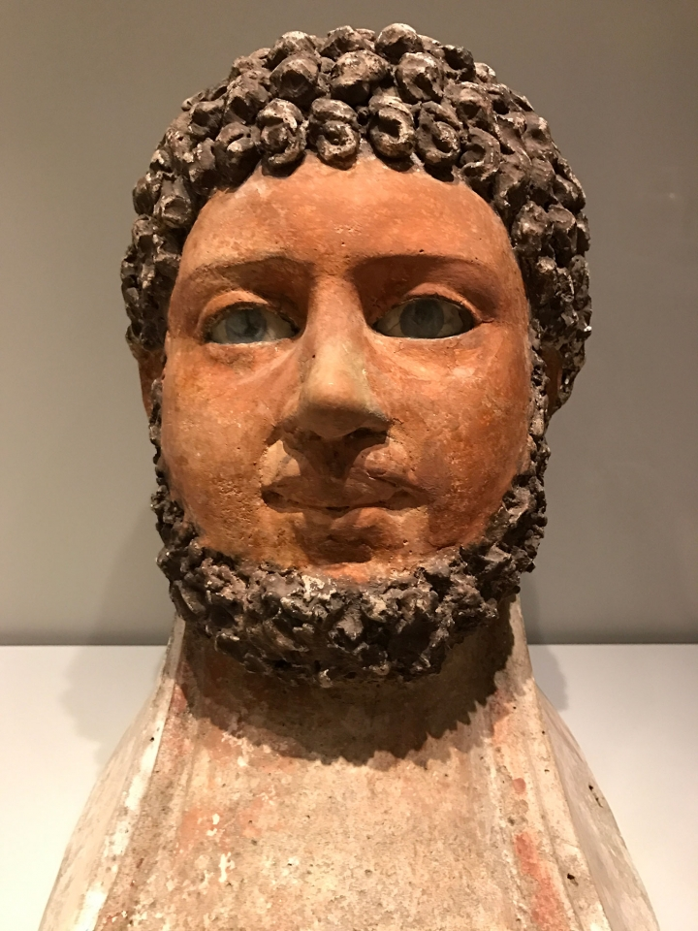
A painted Romano-Egyptian mummy mask of a man (late 2nd century CE)
Notes:
Using unsupervised clustering on samples of DNA from different populations worldwide, geneticists can differentiate about 23 different human ancestries. But there are several obstacles to determining ancestry labels for DNA samples.
Due to heavy gene flow (wink, wink - that’s the technical term for our ancestors fucked) throughout all 200,000 years of modern human history, the vast majority of individuals (97%) on all continents have some degree of mixed ancestry. That is, migration events in the distant past led to enough intermixing between populations that almost no one today belongs to just 1 of those 23 populations.
Additionally, the variance present between the populations is much smaller than the variance present between individuals locally. For example, me and another random south indian will have the same amount of DNA variance as me and Anne.
------------------------
Cit: Templeton, Biological Races in Humans. Page 12.
“Most of our genetic variation exists as differences between individuals, with between population differences being very small.
Painting on , plaster, paint, glass, now at the Rhode Island School of Design (photo by the author for Hyperallergic)

Slide 15
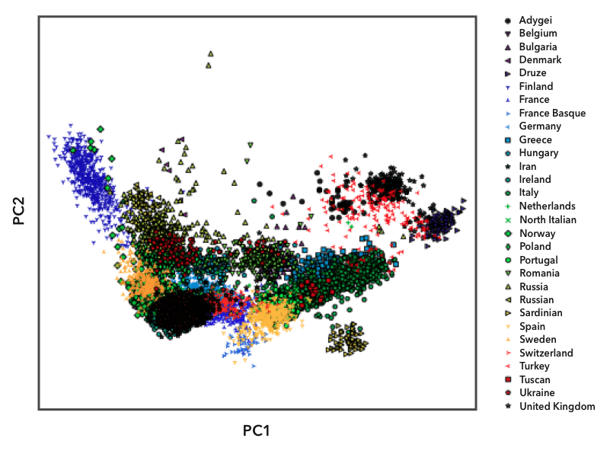
Finland
Norway
Notes:
As an example of how there are no clear genetic categories for an individual, see this PCA clustering of a sample of 23AndMe’s customers in Europe, within a single continent. This is *after* careful selection of reference populations for each country - looking specifically for individuals with all four grandparents from a single region, who were not believed to have migrated within the last several hundred years.
You can see the variance within a population is very wide, and since most populations are overlapping, the distance between two populations is not as wide.
It’s possible to clearly distinguish some populations from each other: see that the Finnish population on the far left side are outliers on the graph, due to their relative isolation from the rest of Europe. However, for any single individual, it’s unclear which population they might fall into because all the populations overlap to some extent - see that the green dots representing people from Norway overlaps partially with Finland. At best you could narrow it down to 2 countries.

Slide 16
“We are able to distinguish as many sub-populations from Europe as across all of Asia.” - 23AndMe website
Notes:
There’s also a major social flaw with genetics testing:
23AndMe/Ancestry database is most popular with European White and Asian populations, so those segments have much richer data available. It’s also true of genetics datasets available to academia and governments: mostly European.
resources:
https://www.ncbi.nlm.nih.gov/pmc/articles/PMC3079573/: Genome wide association studies in European populations have issues with extending to non-European populations
https://www.23andme.com/ancestry-composition-guide/

Slide 17
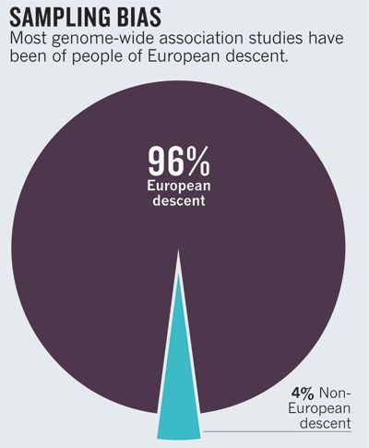
Notes:
Lack of data on other ancestries, like African or Indigenous American makes it difficult to determine the causes of genetic diseases in those populations, which hinders the development of therapies.
Unfortunately the work of studies to identify genetic risk variants based on European databases will not fully translate to other non-European populations.
https://www.nature.com/articles/475163a

Slide 18
But adding more data will not solve ancestry profiling!

Slide 19
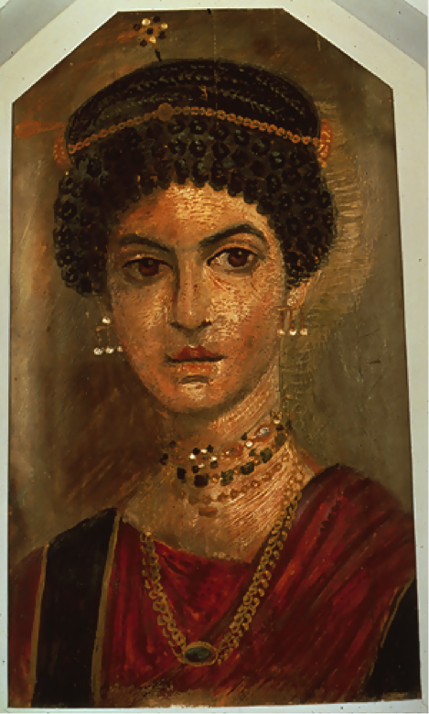
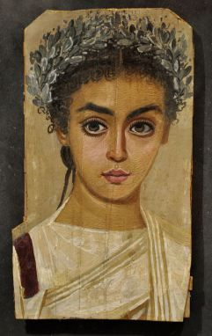
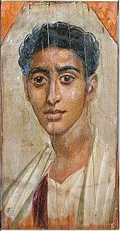
Fayum mummy portraits. Egypt, c. 100 C.E
Notes:
These are portraits that were buried with mummies, of people who lived 2000 years ago in North Africa. Ancestry testing will always be confounded by the fact that our ancestors engaged in multiple mass-migrations in the distant past, which have exponentially increased over the last several thousand years to current day.

Slide 20
One great flaw with all DNA analysis:
It ignores the importance of effect size to the phenotype
Notes:
: Although genes determine physical traits, the final expression of the gene is heavily determined by the various promoters and repressors around the gene. Hence using % difference between individuals’ genomes can be very misleading.
<We can only see phenotypes but this is not the same as ancestry. But the choice of which SNPs to use as racial markers is based on the observable phenotypes of individuals>

Slide 21
Let’s Hack

Slide 22
Let’s Hack--Intuitively

Slide 23
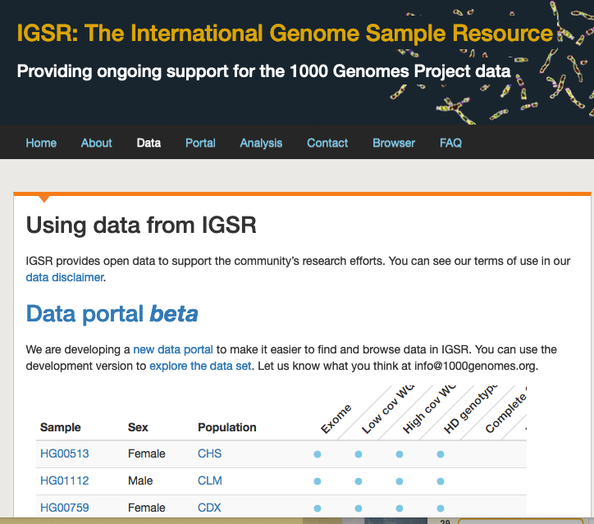
Technical Intuition - Background
Label reference populations (french, chinese, indian, etc)
Cluster and define the genetic commonality within each population
Project this definition onto a new DNA sample in order to get its admixture report (ancestry)
Notes:
We are hacking ancestry or admixture
Technical Admixture involves
CHS: Southern Han Chinese
CLM: Colombians from Medellin, Colombia
CDX: Chinese Dai in Xishuangbanna, China

Slide 24
Technical Intuition - Background
Label reference populations (french, chinese, indian, etc)
Cluster and define the genetic commonality within each population
Project this definition onto a new DNA sample in order to get its admixture report (ancestry)
Notes:
We are hacking ancestry or admixture
Technical Admixture involves

Slide 25
Technical Intuition - “Vulnerability”
The data is shallow
The exact reference population of these services is unknown
The data is under-defined/specified
There is no audit process for ancestry “verification”
Depending on the reference populations, the algorithm can learn based on signal unique to this particular reference data and not necessarily unique to the underlying ancestry populations

Slide 26
Technical Intuition - Hack
Goal: Shift DNA sample from original ancestry to target ancestry
Cluster with all the data as normal
Score all the data against the sample data
~Hack~
From target ancestry data keep data that are closest to the sample
From original ancestry data remove data that are closest to the sample
Cluster again - this will shift the ancestry
Notes:
Run PCA on all the data -> number of centers/ancestry populations
Make a dictionary of `scores` that stores keys of ancestry populations to values of lists of tuples with each tuple representing another id with the distance that id is from the `test_sample` scores[“CHS”] = [(float_of_distance([snps,...],_id),(float_of_distance([snps,...],_id),...]
We chose the highest scores to cluster

Slide 27
Let’s Hack--For Real

Slide 28
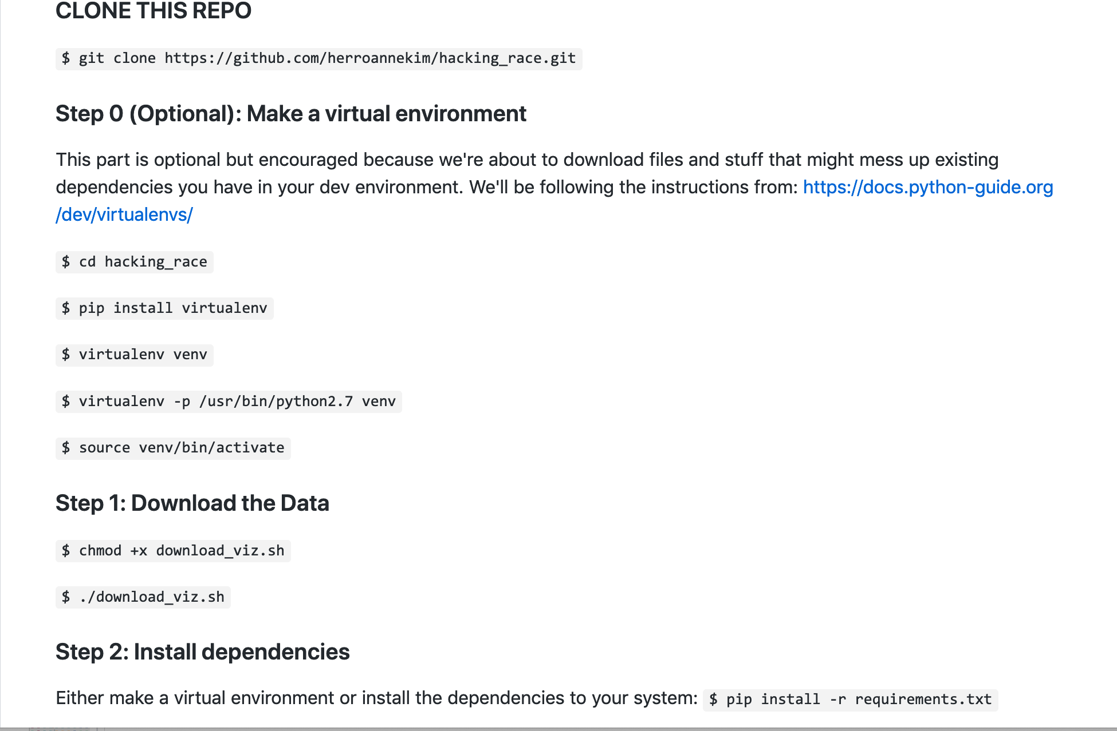
Clone the Repository and Follow
Notes:
Please clone our repository: https://github.com/herroannekim/hacking_race
You’ll want to pip install plink, ugtm, numpy, scikitlearn, matplotlib,
We’ll be working with the 1000 Genome dataset: https://www.genome.gov/27528684/1000-genomes-project/

Slide 29
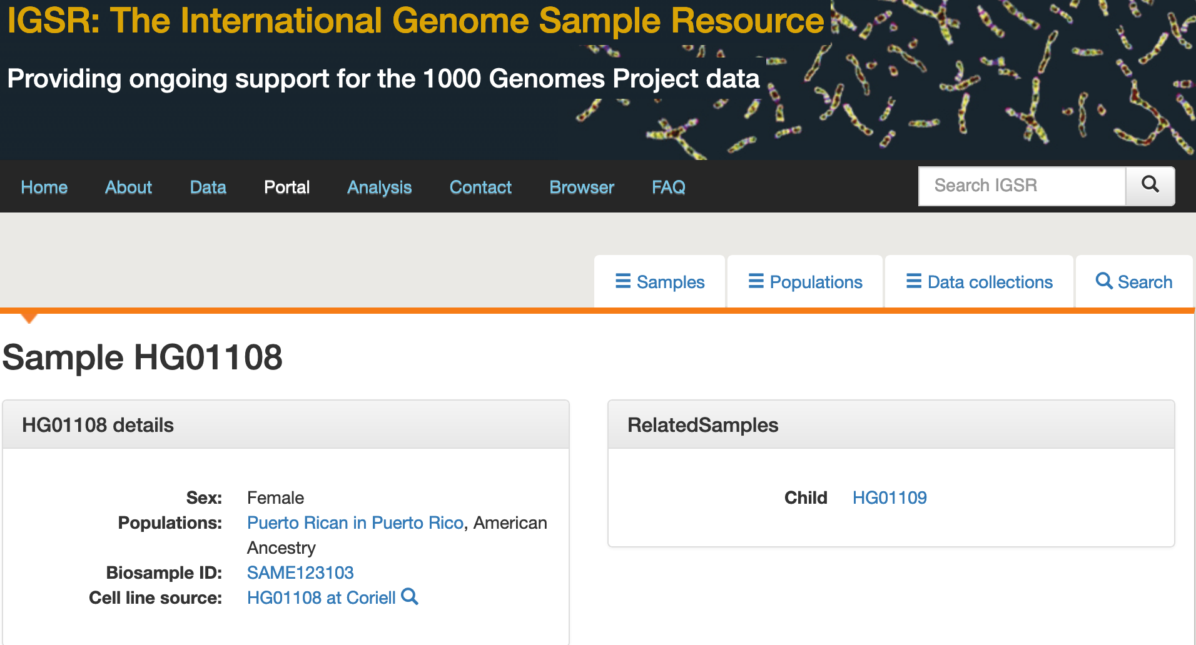
Sample HG01108
Notes:
Puerto Rican Female: https://www.internationalgenome.org/data-portal/sample/HG01108

Slide 30
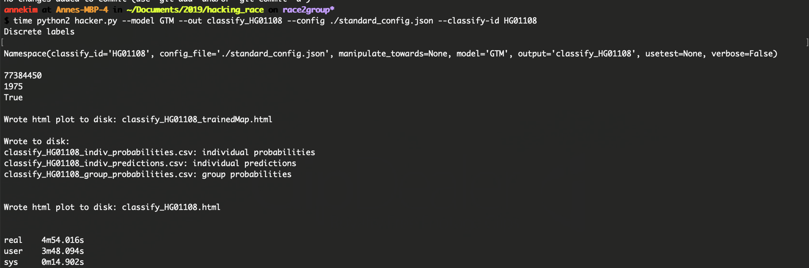
Cluster Command

Slide 31
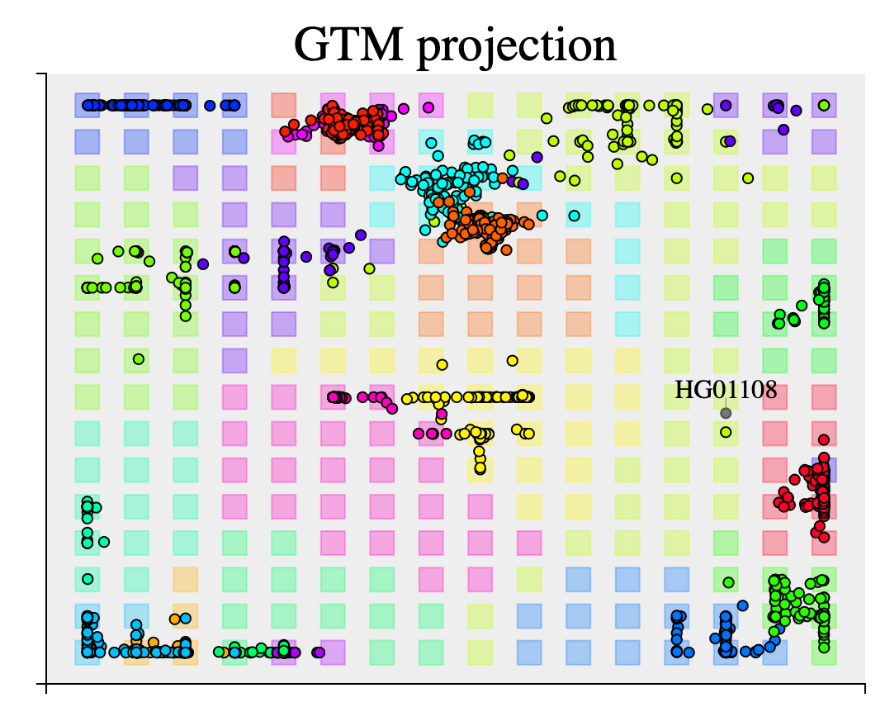
Cluster Visual via `classify_HG01108.html`
Notes:
classify_HG01108.html

Slide 32
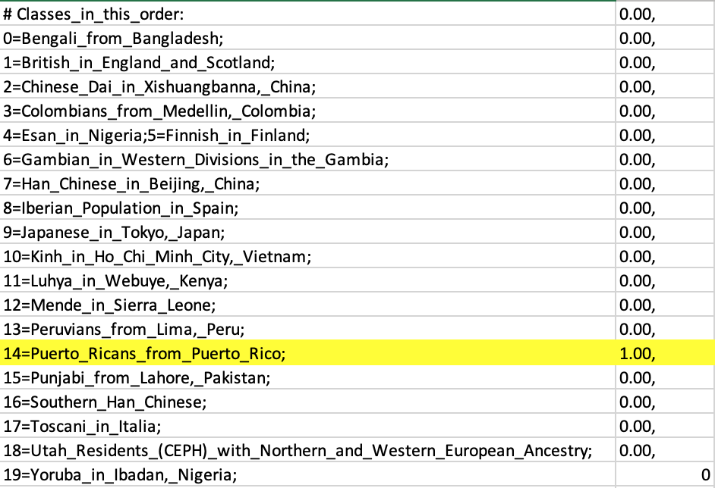
HG1108 Original Ancestry

Slide 33
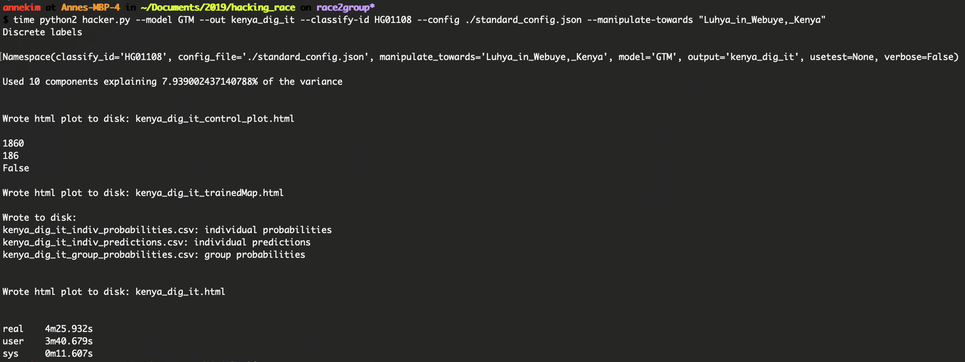
Hack Command

Slide 34
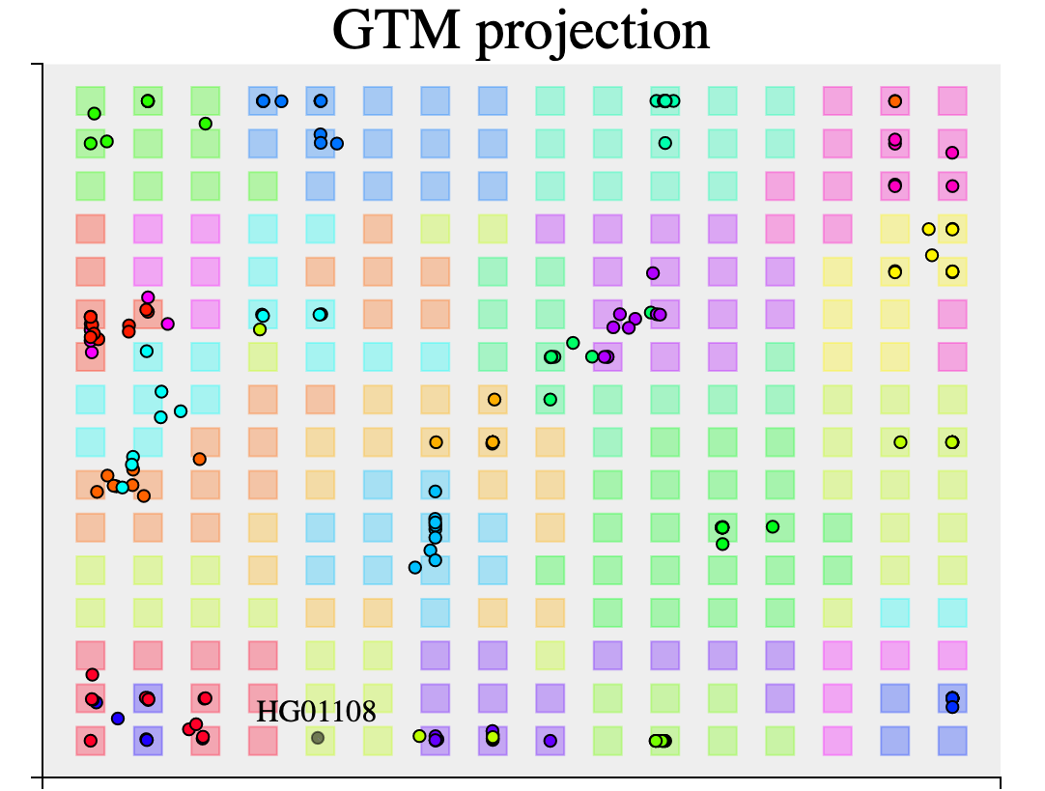
Hack - Visual via `kenya_dig_it.html` and `kenya_dig_it_trainedMap.html`

Slide 35
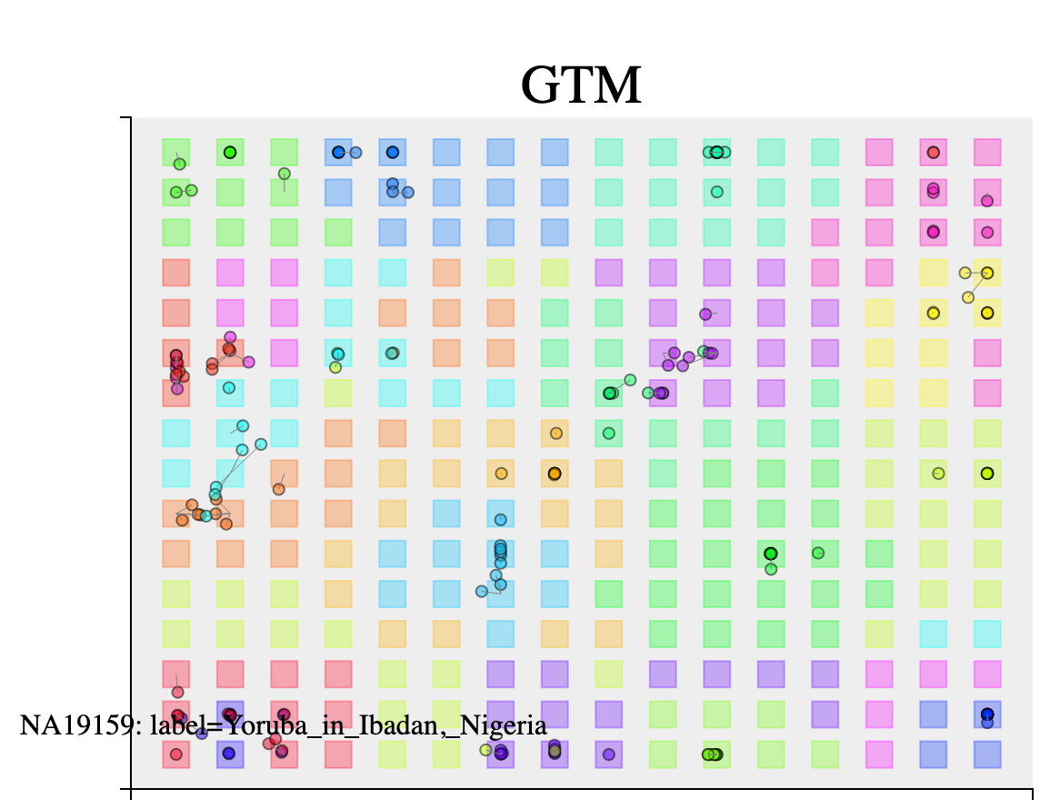
Hack - Visual via `kenya_dig_it.html` and `kenya_dig_it_trainedMap.html`

Slide 36
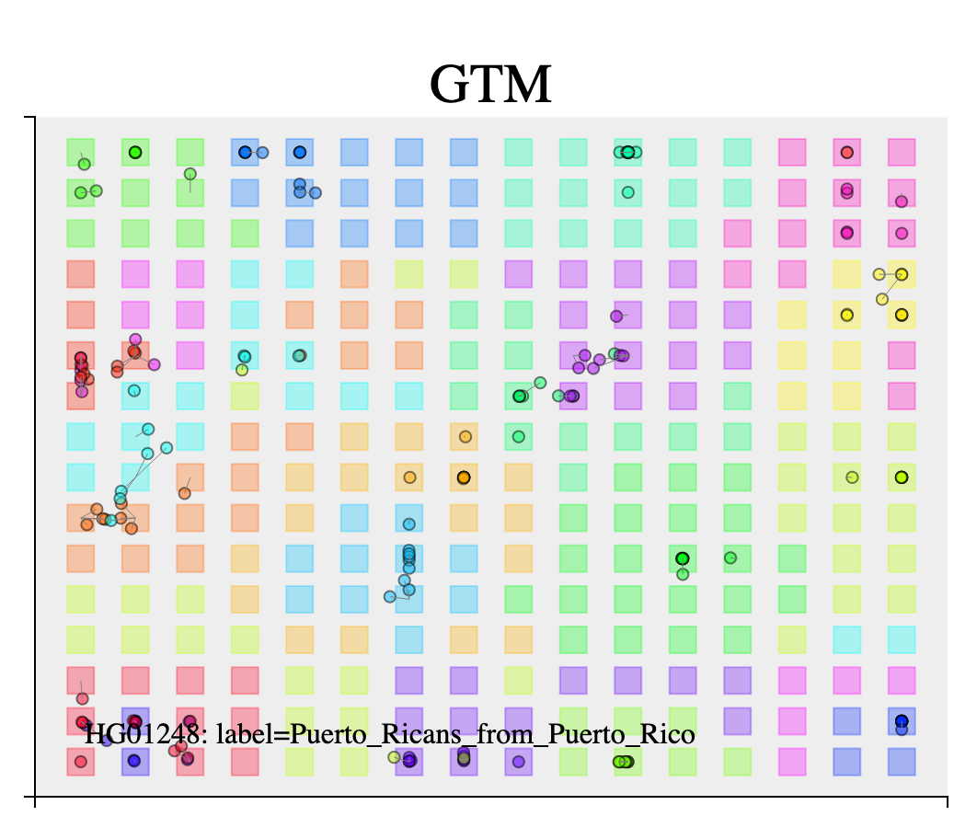
Hack - Visual via `kenya_dig_it.html` and `kenya_dig_it_trainedMap.html`

Slide 37
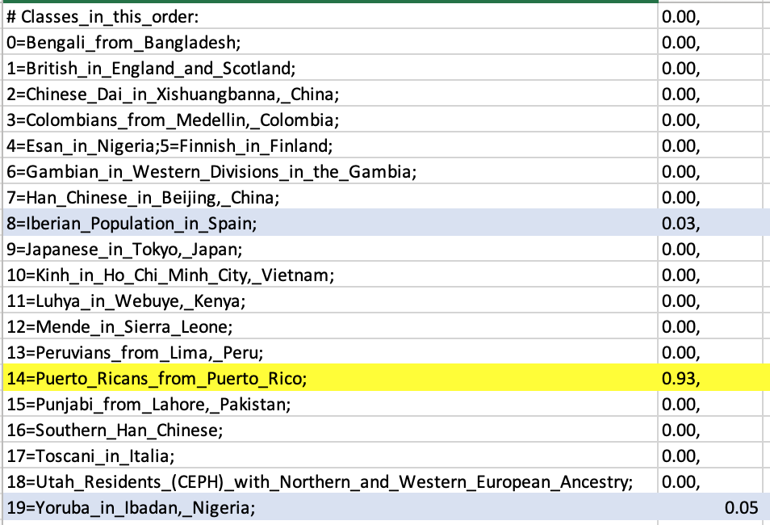
HG1108 Target Ancestry

Slide 38
Pause--What’s up here

Slide 39
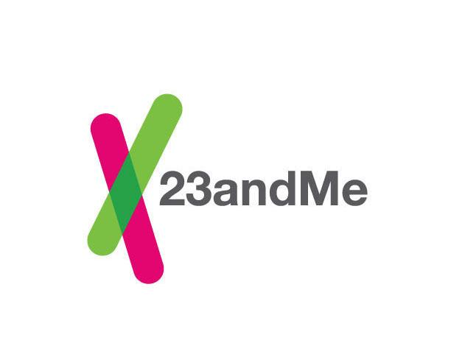
Prompts: Algorithmic fallibility
t-SNE+DBSCAN does not preserve distance the way that PCA does
This set, as well as the algorithm used is opaque to the public as it is considered proprietary to 23AndMe.
Notes:
https://www.23andme.com/ancestry-composition-guide/
Raises the degree to which the choice of clustering algo can influence racial diagnosis, also that the algos are arbitrary

Slide 40

Prompts: Social and Policy
Who creates the SNP panel at genetic testing companies? At governments?
Notes:
https://www.census.gov/topics/population/race.html

Slide 41
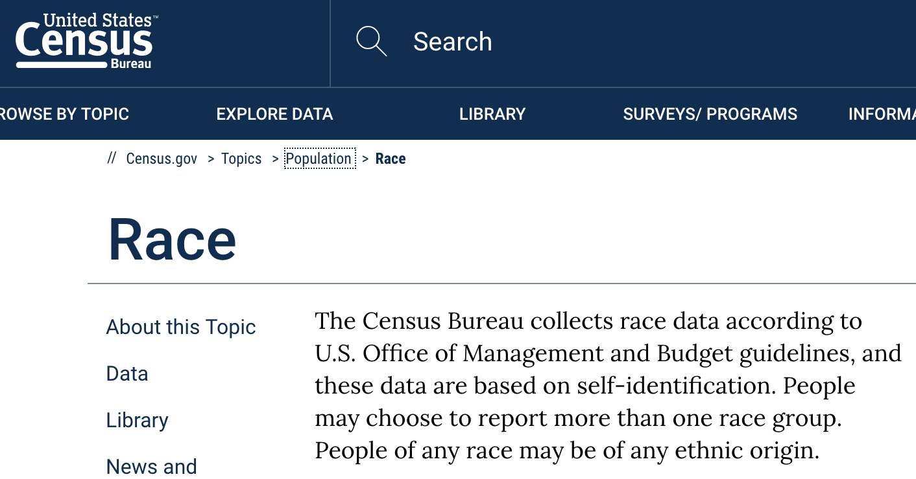
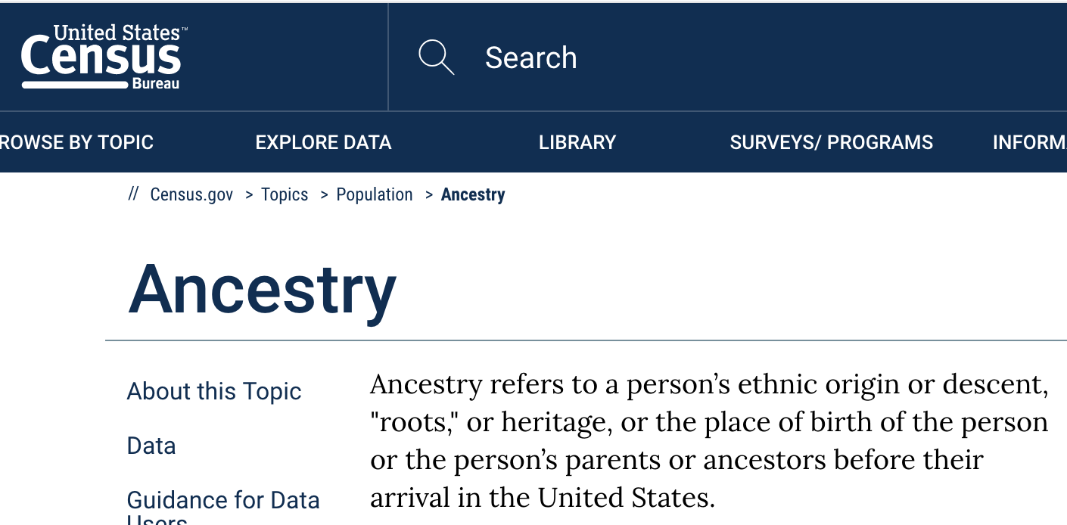
Prompts: Social and Policy
Who creates the SNP board at genetics testing companies? At governments?
The selection of which SNPs to use as ethnicity markers will identify the placement of those races - literally determining ethnic boundaries.
Notes:
resources:
https://www.census.gov/topics/population/race.html

Slide 42
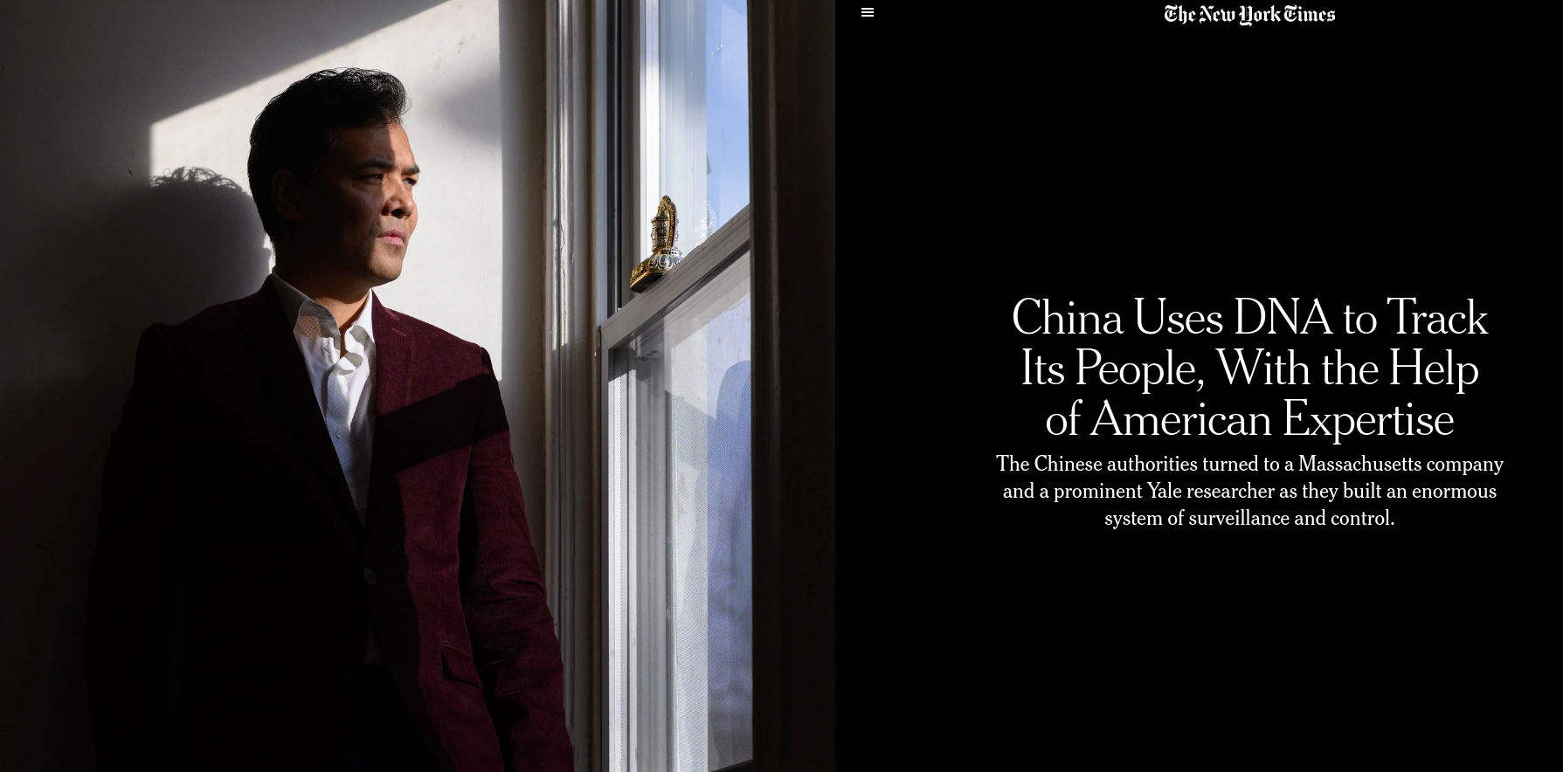
Notes:
Recent news: Chinese tracking minority Uyghur population
What is stopping the US government from

Slide 43
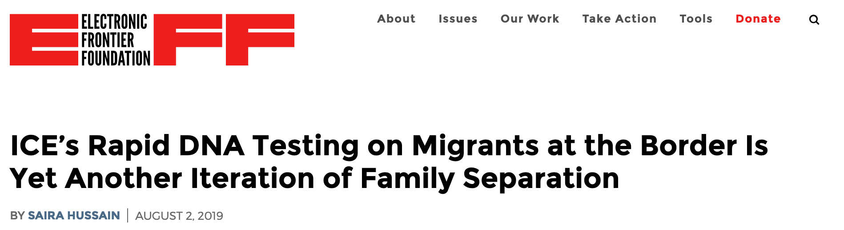
DNA and ICE
Notes:
https://www.eff.org/deeplinks/2019/08/ices-rapid-dna-testing-migrants-border-yet-another-iteration-family-separation

Slide 44
Pls don’t put a lot of stock in the ancestry reports in direct-to-consumer genomics products

Slide 45
Thanks!

Slide 46
Appendix

Slide 47
Resources - Datasets
Datasets
https://www.genome.gov/27528684/1000-genomes-project/
https://www.genome.gov/10001688/international-hapmap-project/
UK Biobank
https://my.pgp-hms.org/public_genetic_data?data_type=23andMe

Slide 48
Resources Code
https://github.com/snehitp/cehg16-workshop
https://github.com/pcgoddard/Burchardlab_Tutorials/wiki/ADMIXTURE
https://github.com/jacahill/Admixture
http://www.y-str.org/2014/04/bam-analysis-kit.html
https://github.com/pcgoddard/Burchardlab_Tutorials/wiki/ADMIXTURE
https://pypi.org/project/admix/

Slide 49
Resources
"ADMIXTURE is a program for estimating ancestry in a model-based manner from large autosomal SNP genotype datasets, where the individuals are unrelated (for example, the individuals in a case-control association study)."
http://software.genetics.ucla.edu/admixture/admixture-manual.pdf:
https://genome.cshlp.org/content/19/9/1655.short
https://journals.plos.org/plosgenetics/article/authors?id=10.1371/journal.pgen.1000519
https://journals.plos.org/plosone/article/authors?id=10.1371/journal.pone.0032840
Ancestry testing uses SNP variant testing https://ghr.nlm.nih.gov/primer/dtcgenetictesting/ancestrytesting

Slide 50
Resources - Literature
Stamped from the Beginning, Ibrahm Kendi
Cristina Moya at UC Davis
23AndMe ancestry composition explanation https://www.23andme.com/ancestry-composition-guide/ and whitepaper linked on site
AAA Statement on Race https://www.americananthro.org/ConnectWithAAA/Content.aspx?ItemNumber=2583
Anthropologists view on Race and Genetics https://onlinelibrary.wiley.com/doi/full/10.1002/ajpa.23120
[Baker, 2017] Human ancestry correlates with language and reveals that race is not an objective genomic classifier https://www.ncbi.nlm.nih.gov/pmc/articles/PMC5431528/
[Templeton 2013] Biological Races in Humans https://www.ncbi.nlm.nih.gov/pmc/articles/PMC3737365/
TechCrunch https://techcrunch.com/2019/01/18/dna-testing-twin-results-show-why-you-should-take-dna-analysis-with-a-grain-of-salt/

Slide 51
Resources
GTM and t-SNE classification and clustering of 1000 Genomes Project populations https://github.com/hagax8/ancestry_viz
Worldmap visualization of 1000Genomes data https://lovingscience.com/ancestries/…
The end of the start for population sequencing https://www.nature.com/articles/526052a
List of resources: https://www.livinganthropologically.com/race-is-a-social-construction/

